Slide 1
Navigating the QuickBase System
SAMHSA’s Faith and Community Based Support Initiative

Slide 2
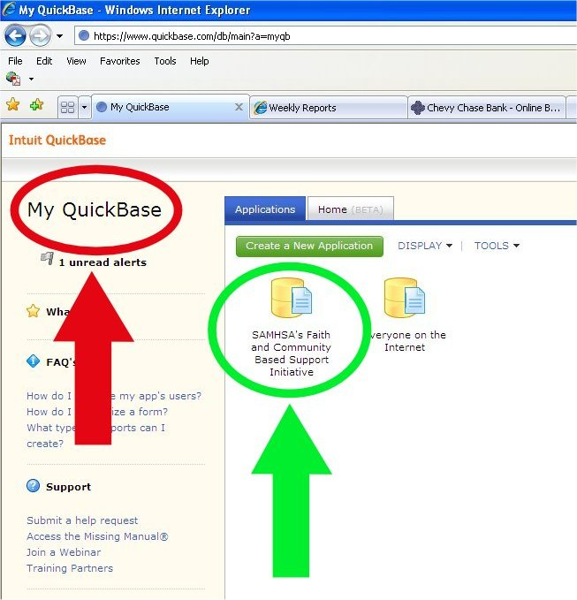
My QuickBase Page
You will see this page if you sign in manually in the Sign In page in QuickBase
Says “My QuickBase” in upper left corner (red arrow)
Has a link to the application where you file your reports (green arrow)
Notes:
The My QuickBase page
Says “My QuickBase” at the upper left corner

Slide 3
Overview Page
Has the US Department of Health and Human Services logo
Go there from the reports pages by clicking on the black button (red arrow)
Go to My QuickBase page by clicking on link (green arrow)
Access Progress Reports by clicking on the menu (blue arrow)
Notes:
The Overview page
Says “United States Department of Health and Human Services” and says “Welcome to SAMHSA's Faith and Community Based Support Initiative Website.”

