Slide 1

Working With Progress Reports
Adding, Viewing and Editing Reports

Slide 2
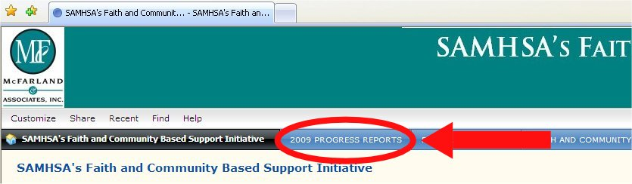
Add a New Progress Report
Click on the blue “Progress Report” button to the right of the black button.

Slide 3
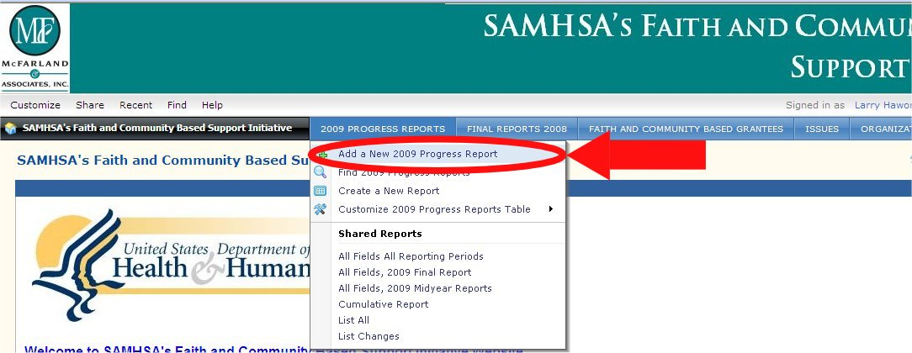
Add a New Progress Report
In the dropdown list select “Add a new Progress Report”

Slide 4
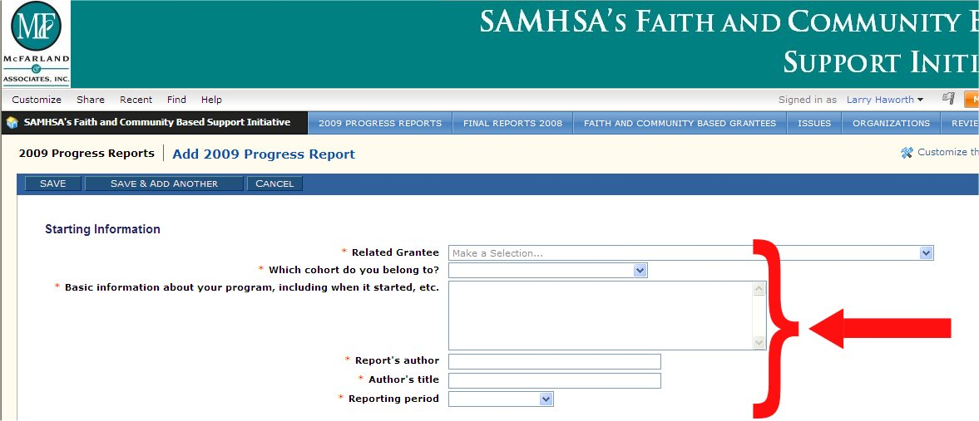
Add a New Progress Report
Fill in the fields; fields with a red asterisk have to be completed to submit your report.

Slide 5
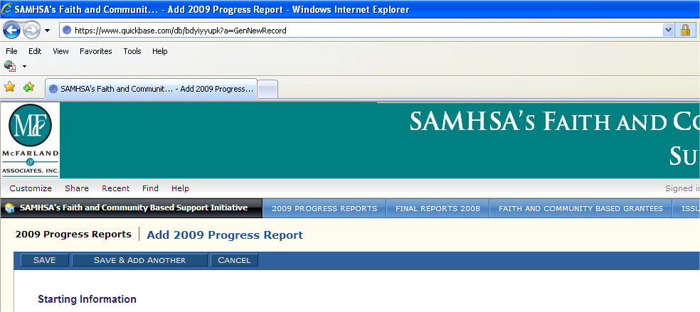
Add a New Progress Report
Save your report by clicking the Save button.

Slide 6
View an Existing Progress Report
Click on the blue “Progress Report” button to the right of the black button.

Slide 7
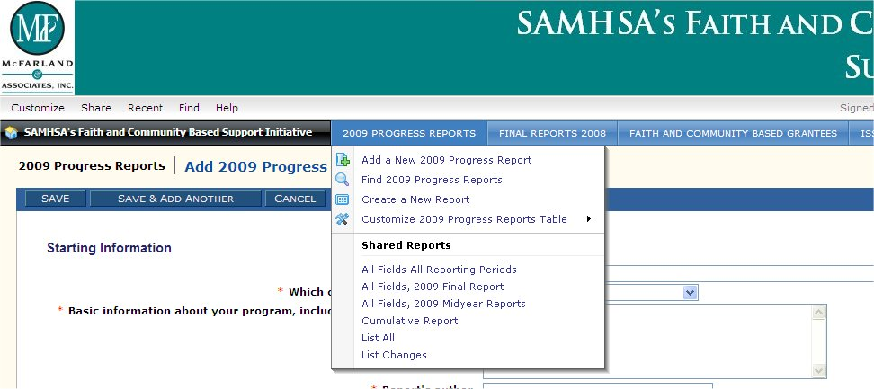
View an Existing Progress Report
In the dropdown list select “List All”

Slide 8
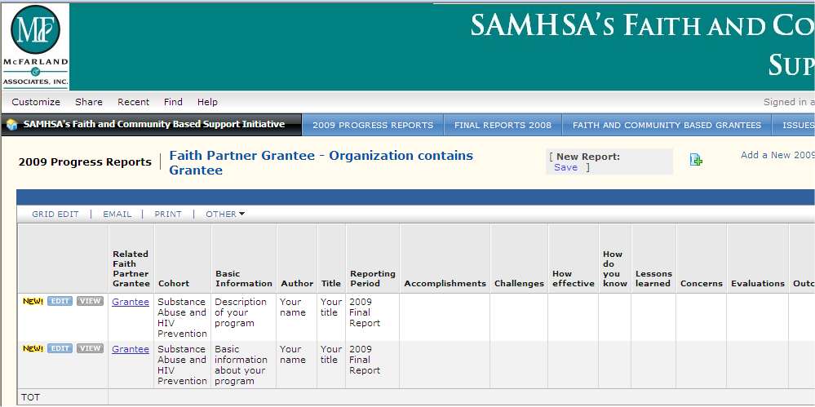
View an Existing Progress Report
The Progress Reports are displayed in rows, one report to a row. At the left of each row are 2 buttons that say “Edit” and “View”.
Click the View button

Slide 9
Edit an Existing Progress Report
Click on the blue “Progress Report” button to the right of the black button.

Slide 10
Edit an Existing Progress Report
In the dropdown list select “List All”

Slide 11
Edit an Existing Progress Report
The Progress Reports are displayed in rows, one report to a row. At the left of each row are 2 buttons that say “Edit” and “View”.
  Click the Edit button of the report you want to edit

